Slide 1
Sorting Algorithms

Slide 2
The Sorting Problem
Input:
  A sequence of n numbers a₁, a₂, . . . , a_{n}
Output:
  A permutation (reordering) a₁’, a₂’, . . . , a_{n}’ of the input sequence such that a₁’ ≤ a₂’ ≤ · · · ≤ a_{n}’

Slide 3
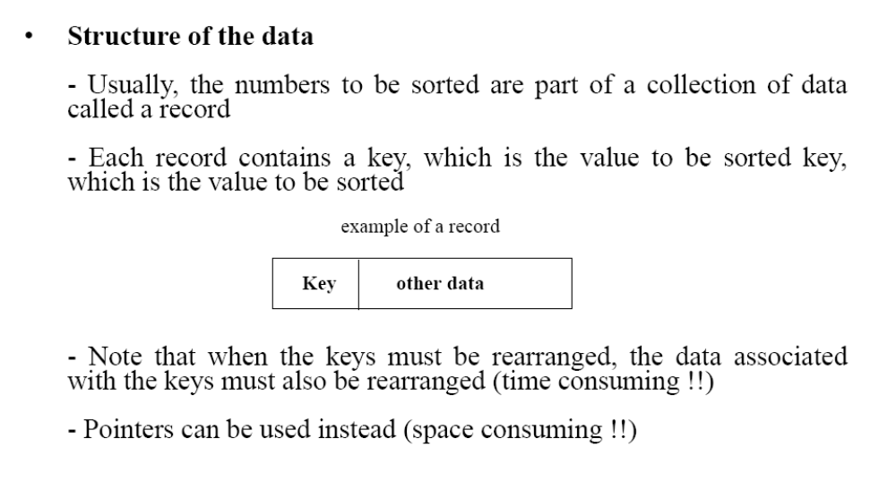
Structure of data

Slide 4
Sorting Algorithms
There are many sorting algorithms, such as:
  Selection Sort
  Insertion Sort
  Bubble Sort
  Merge Sort
  Quick Sort
The first three are the foundations for faster and more efficient algorithms.

Slide 5
Selection Sort
The list is divided into two sublists, sorted and unsorted, which are divided by an imaginary wall.
We find the smallest element from the unsorted sublist and swap it with the element at the beginning of the unsorted data.
After each selection and swapping, the imaginary wall between the two sublists move one element ahead, increasing the number of sorted elements and decreasing the number of unsorted ones.
Each time we move one element from the unsorted sublist to the sorted sublist, we say that we have completed a sort pass.
A list of n elements requires n-1 passes to completely rearrange the data.

Slide 6
Sorted
Unsorted
23 | 78 | 45 | 8 | 32 | 56
8 | 78 | 45 | 23 | 32 | 56
8 | 23 | 45 | 78 | 32 | 56
8 | 23 | 32 | 78 | 45 | 56
8 | 23 | 32 | 45 | 78 | 56
8 | 23 | 32 | 45 | 56 | 78
Original List
After pass 1
After pass 2
After pass 3
After pass 4
After pass 5

Slide 7
Selection Sort (cont.)
void selectionSort( int a[], int n) {
for (int i = 0; i < n-1; i++) {
int min = i; // index of smallest element
for (int j = i+1; j < n; j++)
if (a[j] < a[min]) min = j;
swap(a[i], a[min]);
}
}
void swap( int &lhs, int &rhs )
{
int tmp = lhs;
lhs = rhs;
rhs = tmp;
}

Slide 8
Selection Sort -- Analysis
In general, we compare keys and move items (or exchange items) in a sorting algorithm (which uses key comparisons).
➔ So, to analyze a sorting algorithm we should count the number of key comparisons and the number of moves.
    Ignoring other operations does not affect our final result.
In selectionSort function, the outer for loop executes n-1 times.
We invoke swap function once at each iteration.
➔ Total Swaps: n-1
➔ Total Moves: 3*(n-1) (Each swap has three moves)

Slide 9
Selection Sort – Analysis (cont.)
The inner for loop executes the size of the unsorted part minus 1 (from 1 to n-1), and in each iteration we make one key comparison.
➔ # of key comparisons = 1+2+...+n-1 = n*(n-1)/2
➔ So, Selection sort is O(n²)
The best case, the worst case, and the average case of the selection sort algorithm are same. ➔ all of them are O(n²)

Slide 10
Selection Sort – Analysis (cont.)
  This means that the behavior of the selection sort algorithm does not depend on the initial organization of data.
  Since O(n²) grows so rapidly, the selection sort algorithm is appropriate only for small n.
  Although the selection sort algorithm requires O(n²) key comparisons, it only requires O(n) moves.
  A selection sort could be a good choice if data moves are costly but key comparisons are not costly (short keys, long records).

Slide 11
Insertion Sort
Insertion sort is a simple sorting algorithm that is appropriate for small inputs.
  Most common sorting technique used by
  card players.
The list is divided into two parts: sorted and unsorted.
In each pass, the first element of the unsorted part is picked up, transferred to the sorted sublist, and inserted at the appropriate place.
A list of n elements will take at most n-1 passes to sort the data.

Slide 12
Insertion Sort
Idea: like sorting a hand of playing cards
  Start with an empty left hand and the cards facing down on the table.
  Remove one card at a time from the table, and insert it into the correct position in the left hand
    compare it with each of the cards already in the hand, from right to left
  The cards held in the left hand are sorted
    these cards were originally the top cards of the pile on the table

Slide 13
Insertion Sort
To insert 12, we need to make room for it by moving first 36 and then 24.
6
10
24
36
12

Slide 14
Insertion Sort
6
10
24
36
12

Slide 15
Insertion Sort
10
24
6
36
12

Slide 16
Sorted
Unsorted
23 | 78 | 45 | 8 | 32 | 56
23 | 78 | 45 | 8 | 32 | 56
23 | 45 | 78 | 8 | 32 | 56
8 | 23 | 45 | 78 | 32 | 56
8 | 23 | 32 | 45 | 78 | 56
8 | 23 | 32 | 45 | 56 | 78
Original List
After pass 1
After pass 2
After pass 3
After pass 4
After pass 5

Slide 17
INSERTION-SORT
Alg.: INSERTION-SORT(A)
for j ← 2 to n
do key ← A[ j ]
Insert A[ j ] into the sorted sequence A[1 . . j -1]
i ← j - 1
while i > 0 and A[i] > key
do A[i + 1] ← A[i]
i ← i – 1
A[i + 1] ← key
Insertion sort – sorts the elements in place
1
2
3
4
5
6
7
8
a₁
a₂
a₃
a₄
a₅
a₆
a₇
a₈
key

Slide 18


Comparisons and Exchanges in Insertion Sort
INSERTION-SORT(A)
for j ← 2 to n
do key ← A[ j ]
Insert A[ j ] into the sorted sequence A[1 . . j -1]
i ← j - 1
while i > 0 and A[i] > key
do A[i + 1] ← A[i]
i ← i – 1
A[i + 1] ← key
cost times
c₁ n
c₂ n-1
0 n-1
c₄ n-1
c₅
c₆
c₇
c₈ n-1
comparisons
exchanges

Slide 19
Insertion Sort – Analysis
Running time depends on not only the size of the array but also the contents of the array.
Best-case: ➔ O(n)
  Array is already sorted in ascending order.
  Inner loop will not be executed.
  The number of moves: 2*(n-1) ➔ O(n)
  The number of key comparisons: (n-1) ➔ O(n)
Worst-case: ➔ O(n²)
  Array is in reverse order:
  Inner loop is executed i-1 times, for i = 2,3, …, n
  The number of moves: 2*(n-1)+(1+2+...+n-1)= 2*(n-1)+ n*(n-1)/2 ➔ O(n²)
  The number of key comparisons: (1+2+...+n-1)= n*(n-1)/2 ➔ O(n²)
Average-case: ➔ O(n²)
  We have to look at all possible initial data organizations.
So, Insertion Sort is O(n²)

Slide 20
Bubble Sort
The list is divided into two sublists: sorted and unsorted.
The smallest element is bubbled from the unsorted list and moved to the sorted sublist.
After that, the wall moves one element ahead, increasing the number of sorted elements and decreasing the number of unsorted ones.
Each time an element moves from the unsorted part to the sorted part one sort pass is completed.
Given a list of n elements, bubble sort requires up to n-1 passes to sort the data.

Slide 21
Bubble Sort
23 | 78 | 45 | 8 | 32 | 56
Original List

Slide 22
Bubble Sort (Pass 1)
23 | 78 | 45 | 8 | 32 | 56
23 | 45 | 78 | 8 | 32 | 56
23 | 45 | 8 | 78 | 32 | 56
23 | 45 | 8 | 32 | 78 | 56
23 | 45 | 8 | 32 | 56 | 78
23 | 45 | 8 | 32 | 56 | 78

Slide 23
Bubble Sort (Pass 2)
23 | 45 | 8 | 32 | 56 | 78
23 | 8 | 45 | 32 | 56 | 78
23 | 8 | 32 | 45 | 56 | 78
23 | 8 | 32 | 45 | 56 | 78
23 | 8 | 32 | 45 | 56 | 78

Slide 24
Bubble Sort Algorithm
void bubbleSort(Item a[], int n)
{
boolean sorted = false;
int last = n-1;
for (int i = 0; (i < n-1) && !sorted; i++){
sorted = true;
for (int j=0; j < n-i-1; j++)
if (a[j] > a[j+1]{
swap(a[j],a[j+1]);
sorted = false; // signals exchange
}
}
}

Slide 25
Bubble Sort – Analysis
Best-case: ➔ O(n)
  Array is already sorted in ascending order.
  The number of moves: 0 ➔ O(1)
  The number of key comparisons: (n-1) ➔ O(n)
Worst-case: ➔ O(n²)
  Array is in reverse order:
  Outer loop is executed n-1 times,
  The number of moves: 3*(1+2+...+n-1) = 3 * n*(n-1)/2 ➔ O(n²)
  The number of key comparisons: (1+2+...+n-1)= n*(n-1)/2 ➔ O(n²)
Average-case: ➔ O(n²)
  We have to look at all possible initial data organizations.
So, Bubble Sort is O(n²)

Slide 26
TEST – 3 (5 marks)

Slide 27
Question 1(3 marks)
Write an algorithm / pseudocode to sort an array of ‘n’ binary numbers in O(n) time.
Eg:
Input:
0,1,0,0,1,1,0,0,1,0
Output:
0,0,0,0,0,0,1,1,1,1
Question 2 (2 marks)
Write code for Alternate pass bubble sort
In the first pass loop runs from right to left and in second pass from left to right and so on…

